Slide 1
Network Analysis
By Caylan Barnes &
Bryan Mileski

Slide 2
Milestone 1: Setup & Preparation
Objective:
Analyze network traffic to identify the attackers' IPs, botnet behavior, and C2 communication.
Environment:
Kali Linux VM
Imported CTU-13 PCAP dataset
Conducted log-based forensic review
Zeek, for botnet network traffic analysis to uncover
Attacker IP addresses or infected machines
C2 Channels (IRC, HTTPS, high ports)
Evidence and malware propagation
Signs of spam or data exfiltration
Wireshark
To extract files from pcap file and save suspicious intact files to calculate its hash
Virus Total
Identify any malicious files by searching their hashes

Slide 3
Dataset
PCAP & Hash Verification
Evidence File:
Botnet-capture-20110815-fast-flux.pcap
Hashes:
MD5: ded5f0029af0bcb71f4dc1116b9a2086
SHA-1: 66e32f7867851ca26d3b46b5798d818b6770c1fe
SHA-256: b04dfbdcb5735e64ea28ba801912c55395efca1c69ab0ac5c2672ebfd372a
We used the cryptographic hashes to verify that the PCAP is authentic and unmodified

Slide 4
Milestone 2: Initial Network Survey
Findings
Top Source IP:
88,049 connections with 147.32.84.165
Top Destination IPs:
64162 connections with 184.173.217.40
4,820 connections with 147.32.80.9
IP addresses with many connections to top source IP:
60.190.223.75, 91.220.0.52, 94.163.149.152, 209.173.182.133
Top protocols (in order)
80,232 connections with unidentified protocols, dns, http, ssl, smtp, dce_rpc, and rdp

Slide 5
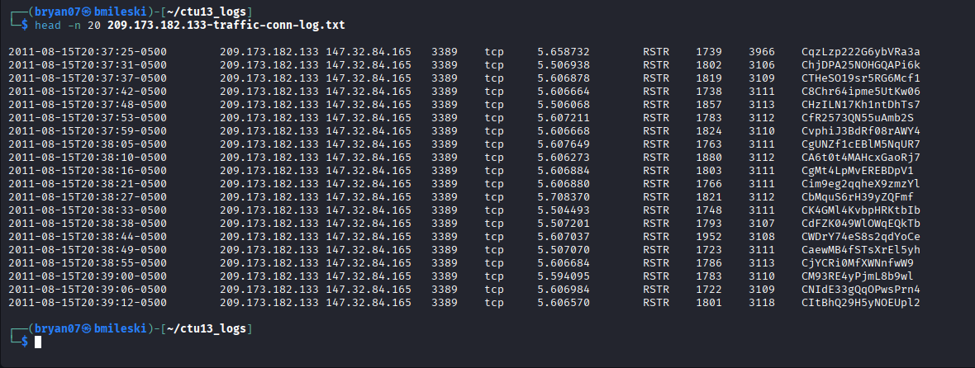
Milestone 3: Attacker Identification
147.32.84.165 is the IP some of the most documented connections
Each connection is initiated at roughly 5 second intervals looking at timestamp on left of top screenshot
More automated, than human browsing
Connection state field is "RSTR", meaning the responder resets the connection, rather than terminating it like normal
209.173.182.133 is communicating on port 3389, standard for Remote Desktop Protocol
This activity started on Mon Aug 15 8:37 PM

Slide 6
Milestone 4: Reconstructing attack methodology
Timeline of suspicious activity:
Mon Aug 15 10:19:51 AM 2011 : 147.32.84.165 sends GET requests to 94.63.149.152 for a suspicious uri called /rus.php
Mon Aug 15 10:21:58 AM to 11:15:53 AM 2011 : Responder 91.220.0.52 sends POST requests of more than 200,000 bytes to suspected infected host 147.32.84.165 a total of 5 times.
Mon Aug 15 02:49:09 PM 2011 : 147.32.84.165 sends GET request to 60.190.223.75 for a suspicious download called /p/out/kp.exe
Mon Aug 15 08:37:25 – 08:43:51 PM 2011 : 209.173.182.133 initiates connections with 147.32.84.165 every 5-6 seconds through RDP protocol

Slide 7
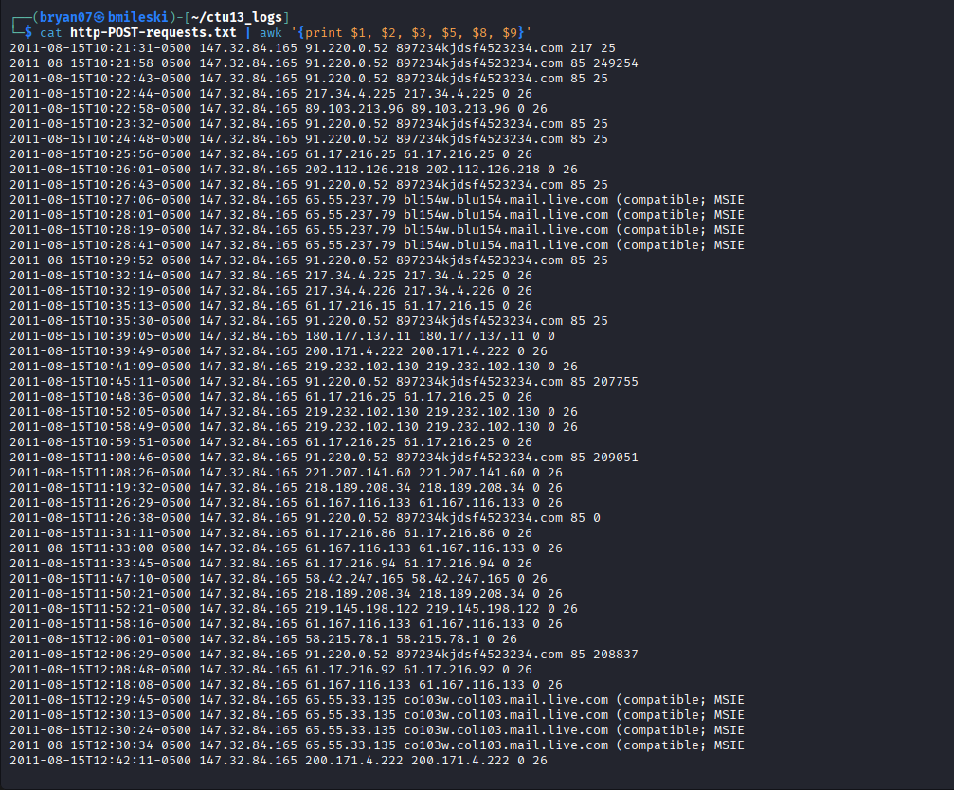
Milestone 5: Data Exfiltration
Following screenshot contains parsed fields from http.log and showing only POST requests
The last 2 columns show orig_bytes and resp_bytes
From time to time there is a sharp increase in byte size of messages, potentially a sign of data exfiltration
Random host names are shown, which could be malware-generated

Slide 8
Milestone 6: Malicious File Carving
The process
Open Wireshark
Go to 'File' top left -> select 'Open'
Locate your pcap file and select it
Go back to 'File' top left -> 'Export Objects'
In our case, we selected 'HTTP' stream
In small pop-up window, filter for connection with suspicious file by looking for the host it was from and select it to open and save it to your file system
Go to linux terminal to find the file
Type 'sha256sum (filename)'
Copy the hash it gives you
Go to VirusTotal website, and paste the hash in search bar
Results shows you how many vendors have rated it as malicious and what they labeled it as

Slide 9
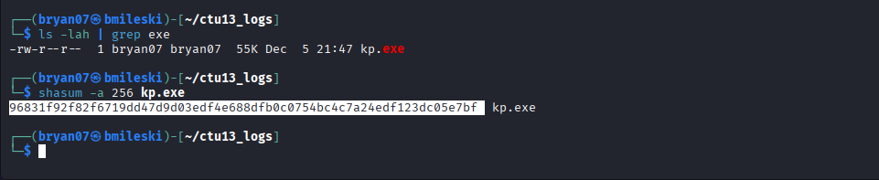
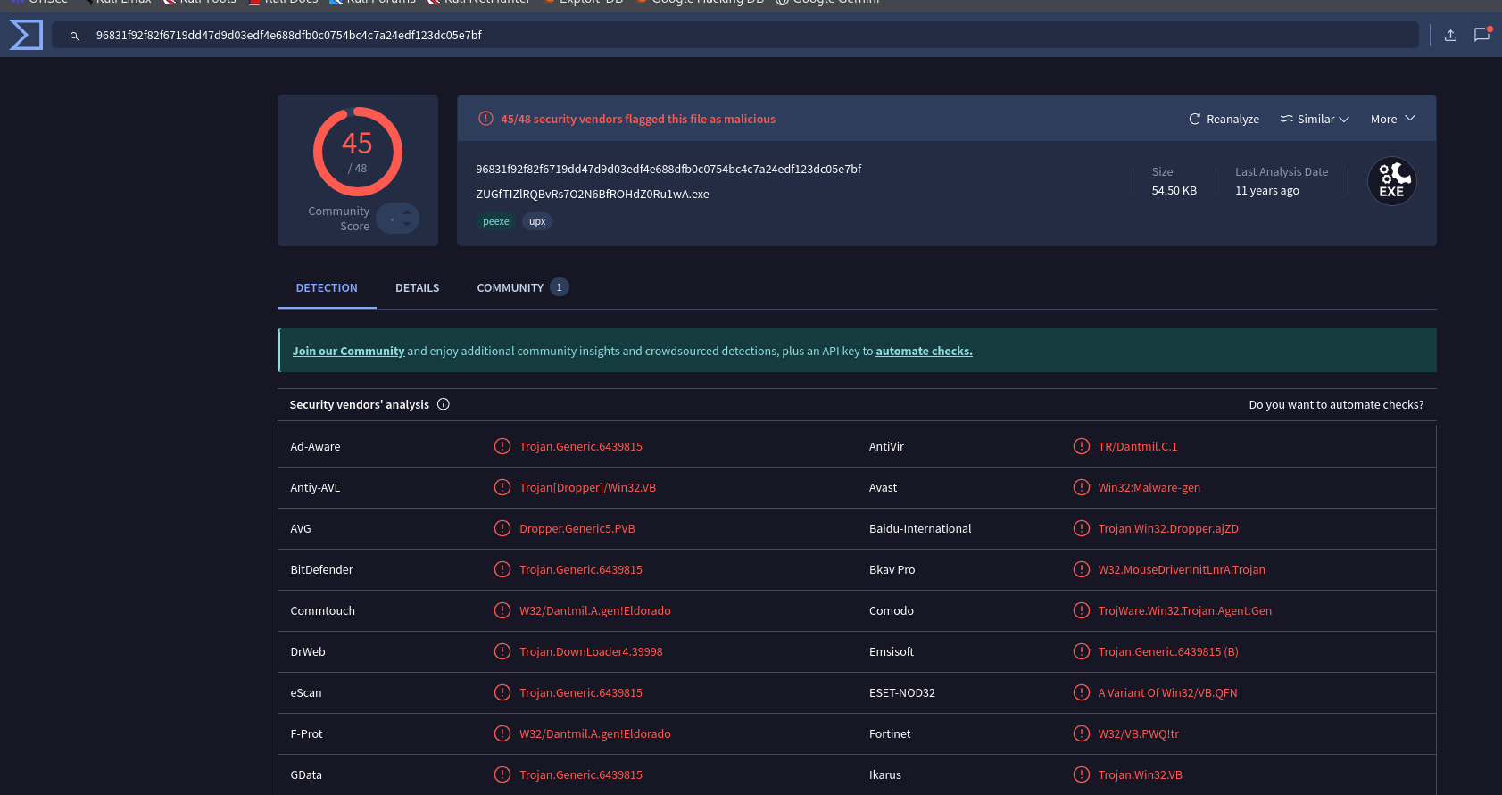
Milestone 6: Malicious File Carving
Suspicious file name: kp.exe
Top figure: calculating SHA256 hash of malicious file
Bottom figure: results from VirusTotal stating that 45/48 vendors classified it as malicious

Slide 10
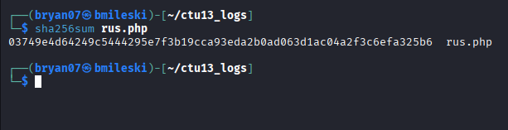
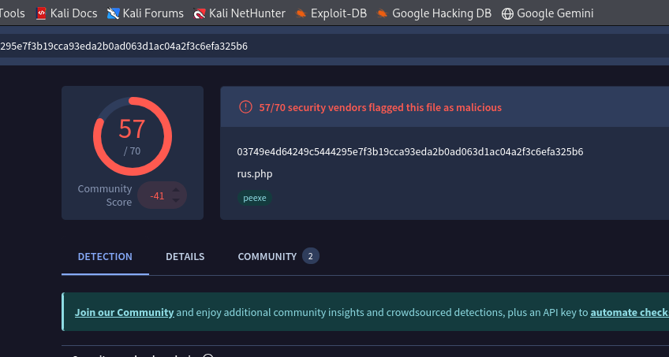
Milestone 6: Malicious File Carving
Suspicious file name: /rus.php
Left figure: calculating SHA256 file hash
Right figure: hash is searched on VirusTotal, 57/70 vendors rated it as malicious

Slide 11
Milestone 7: Final report
147.32.84.165
Initiated many connections that occurred at steady intervals of very 5 or 30 seconds, not characteristic of human browsing, and is most likely C2C beaconing
Tried to request malware files such as /rus.php or kp.exe
209.173.182.133
Tried to connect to already compromised 147.32.84.165 at repeated intervals through RDP, all connections were resetted by 147.32.84.165 instead of being gracefully terminated like normal
Interpretation:
This could be a multi-stage attack. The attacker compromised 147.32.84.165 which propagated malware activity and C2C beaconing activity to maintain a persistent channel to the C2 server, allowing the attacker to get a foothold in the network. For the next stage, the attacker, 209.173.182.133, tried to get full control of the network through RDP by connecting to 147.32.84.165. Through RDP, the attacker can escalate their privileges and better explore the network, look for valuable files and sensitive information, configure backdoors, and disable security.

Slide 12
Thank you! Any Questions?

